Slide 1
VanWyk-Zoey_92127628_PJWD _P2_S
GitHub Repository Link: https://github.com/zoeyvanwyk/project--Java-and-Web-development

Slide 2
Purpose of Web App
The purpose of the website is to be a site where people with different types of crafts can come to and look for things they need. The purpose is to be an inviting space where different needle and fabric crafts can come and get the things that they need. The coding behind the site populates the different craft things based on their category type.
Technology Choices
Front-end tech choices:
HTML
CSS
JavaScript
Back-end tech choices:
PostgreSQL
Node.js
Express.js

Slide 3
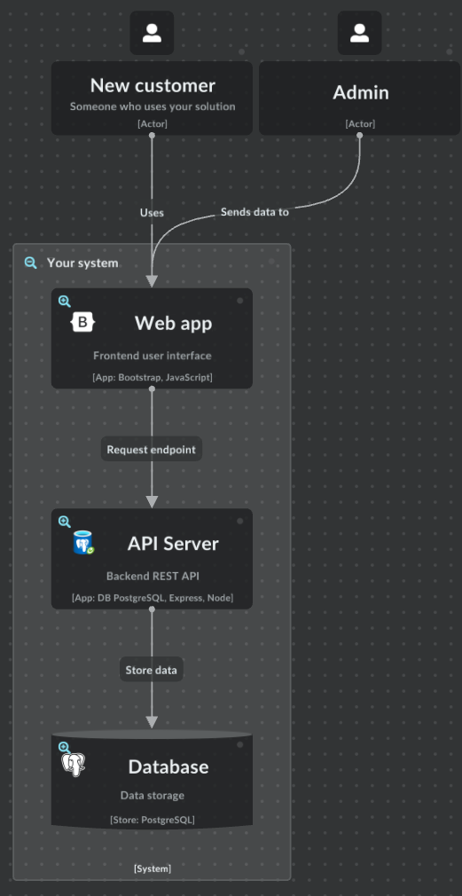
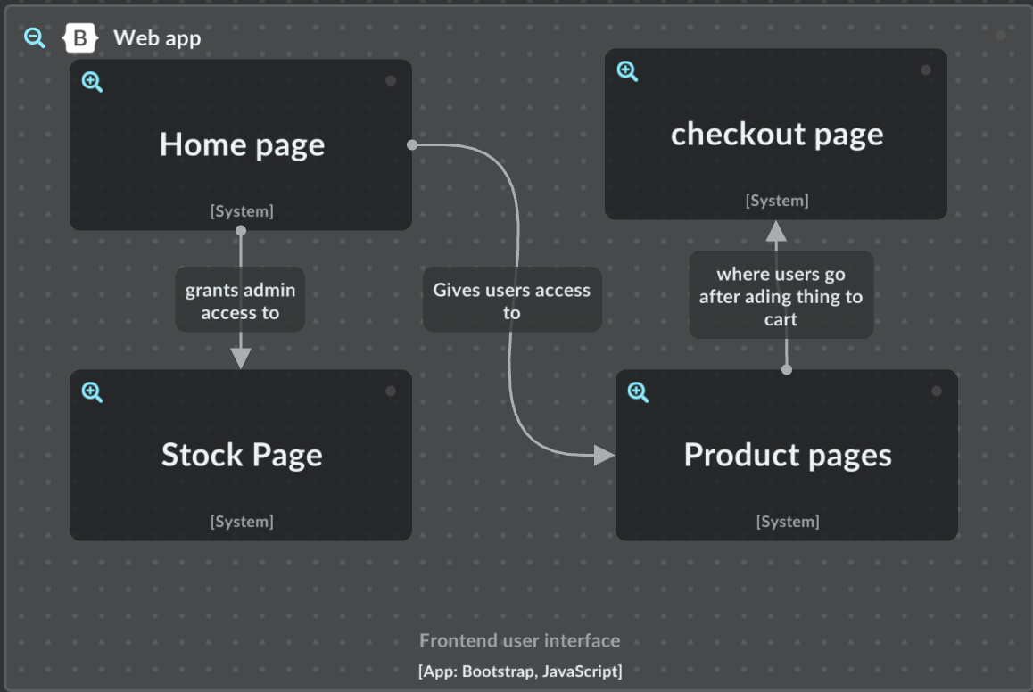
Architecture

Slide 4
Differences between iterations
Aspect/Feature | Original | Change | Reason for Change
Backend | Used Python | Used node.js | Researched and realised it would be a lot easier to do it that way
User logged in | Local storage | Cookies | Safer and lasts longer, and was easier than other methods
Product pages | Hard coded | Inserted using templates | Easier to change and less coding meaning less chance of errors, and was something new to learn
Product information | Entire new page | Cards overlaying page | Looked cleaner, also easier to implement using templates
Stock | Server side only | Own page only admins could access | Easier for admins to add, edit and delete stock from database.

Slide 5
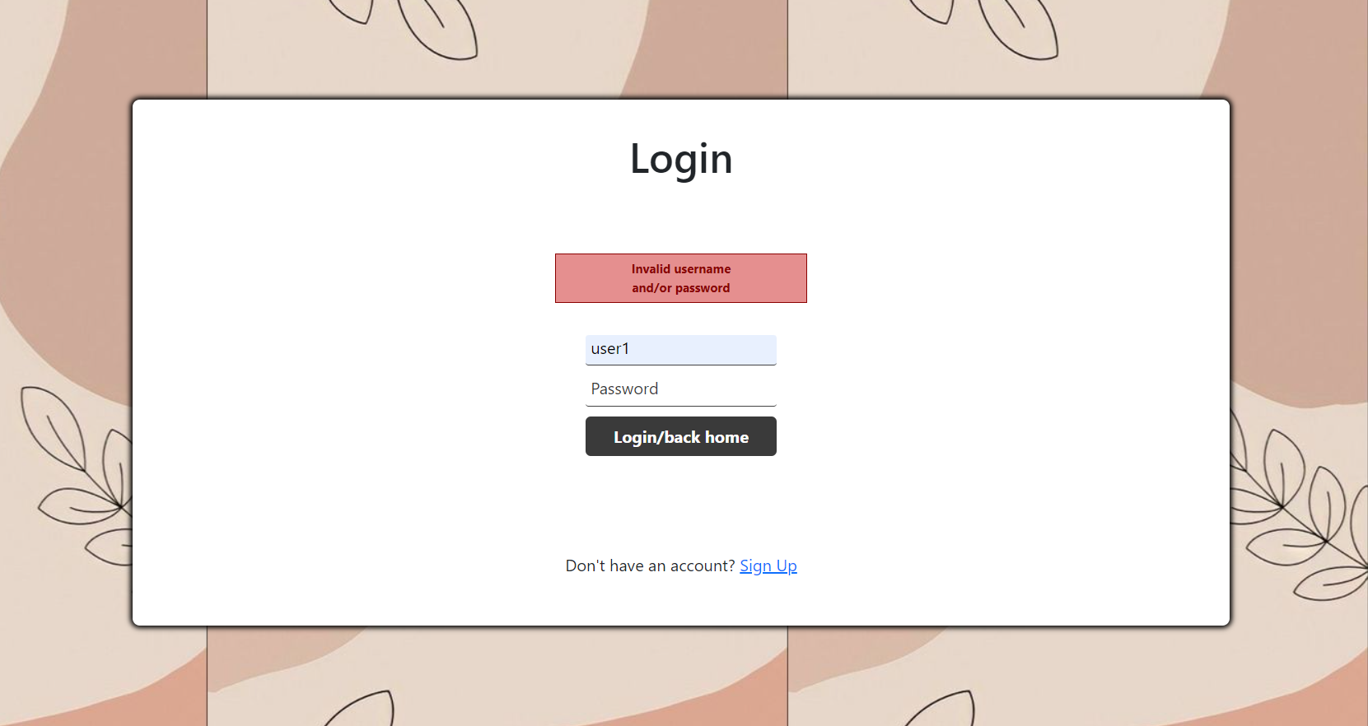
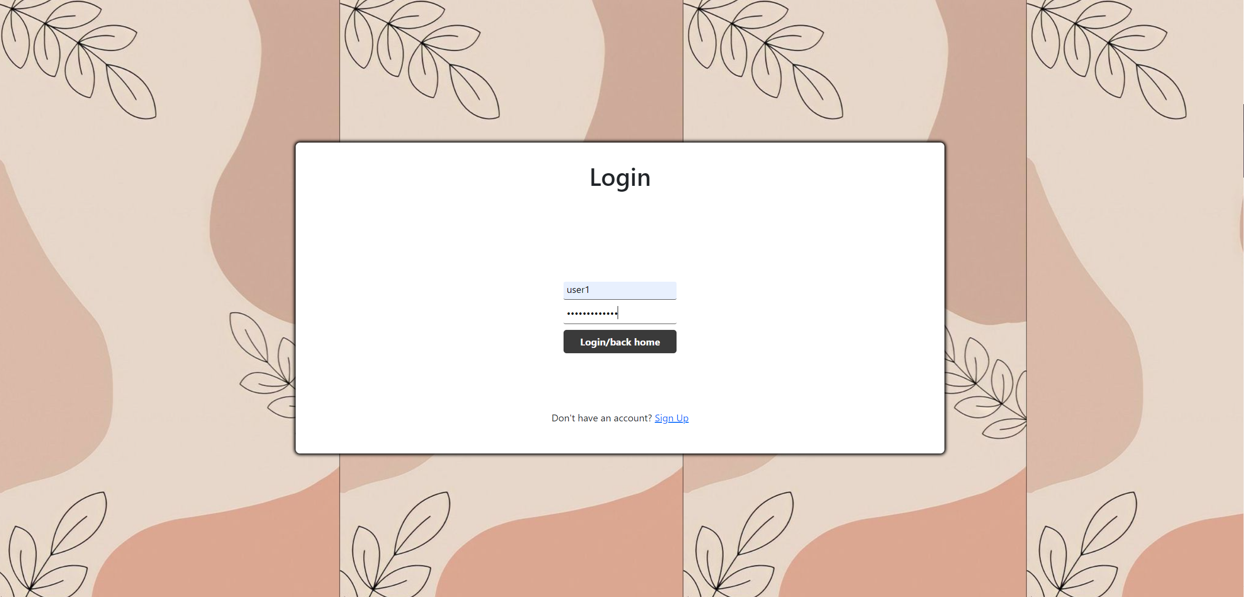
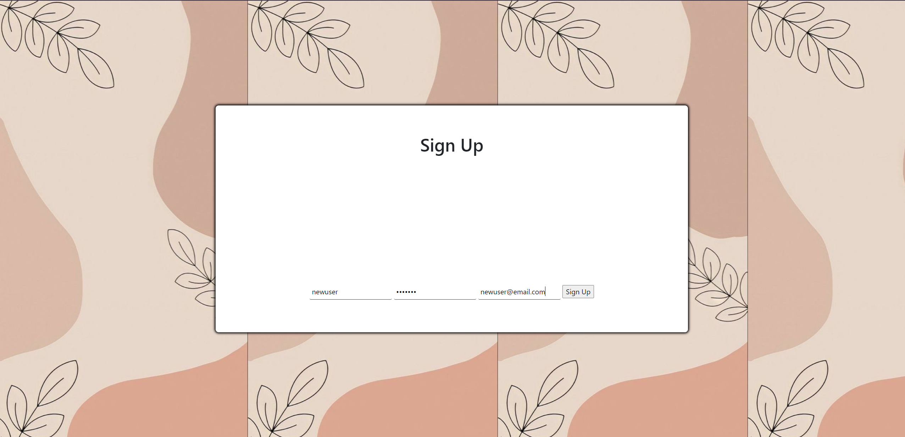
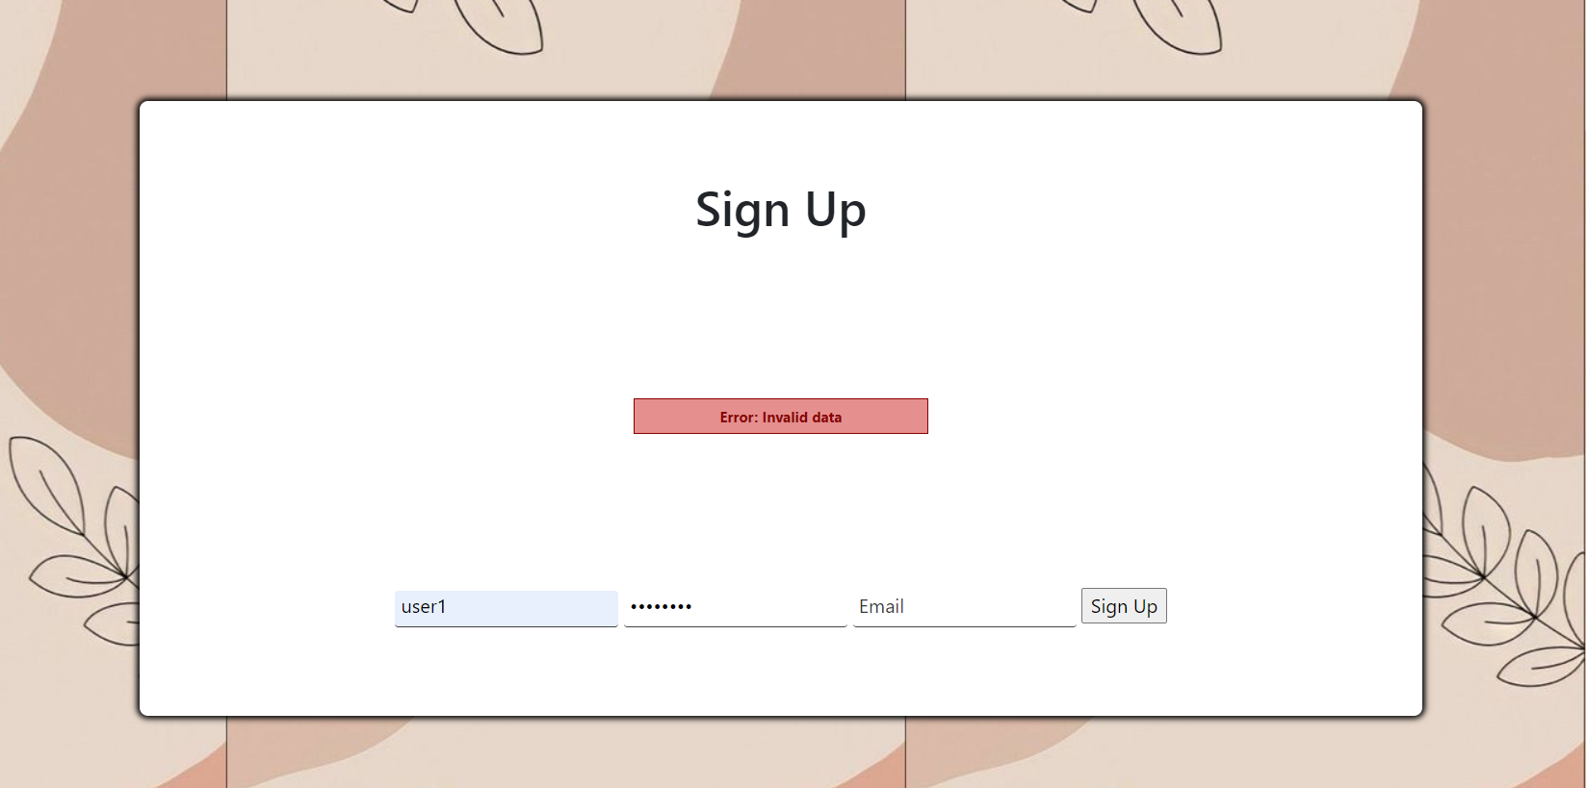
Screenshots with explanations
This is what the login page looks like.
This is what the sign-up page looks like
Errors in both pages look like this

Slide 6
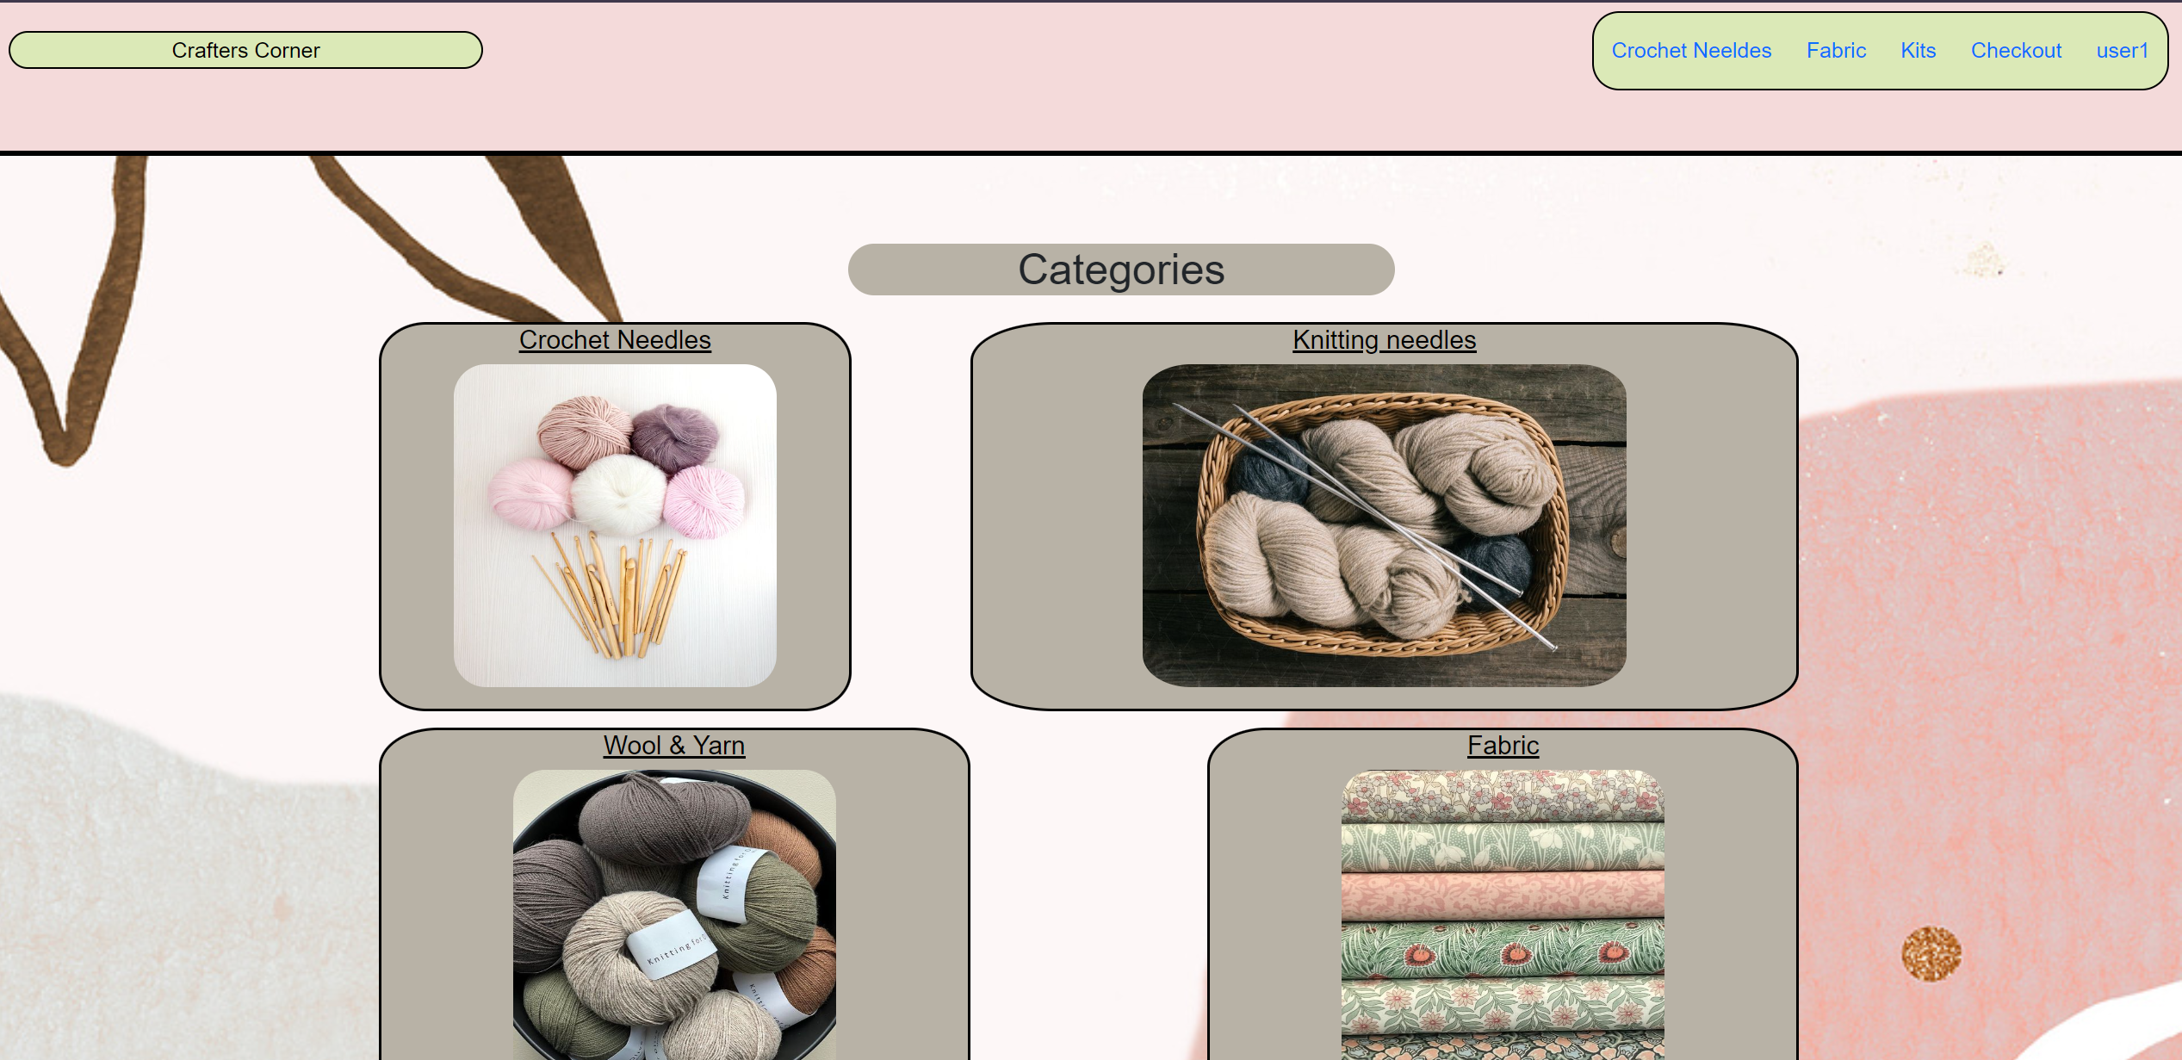
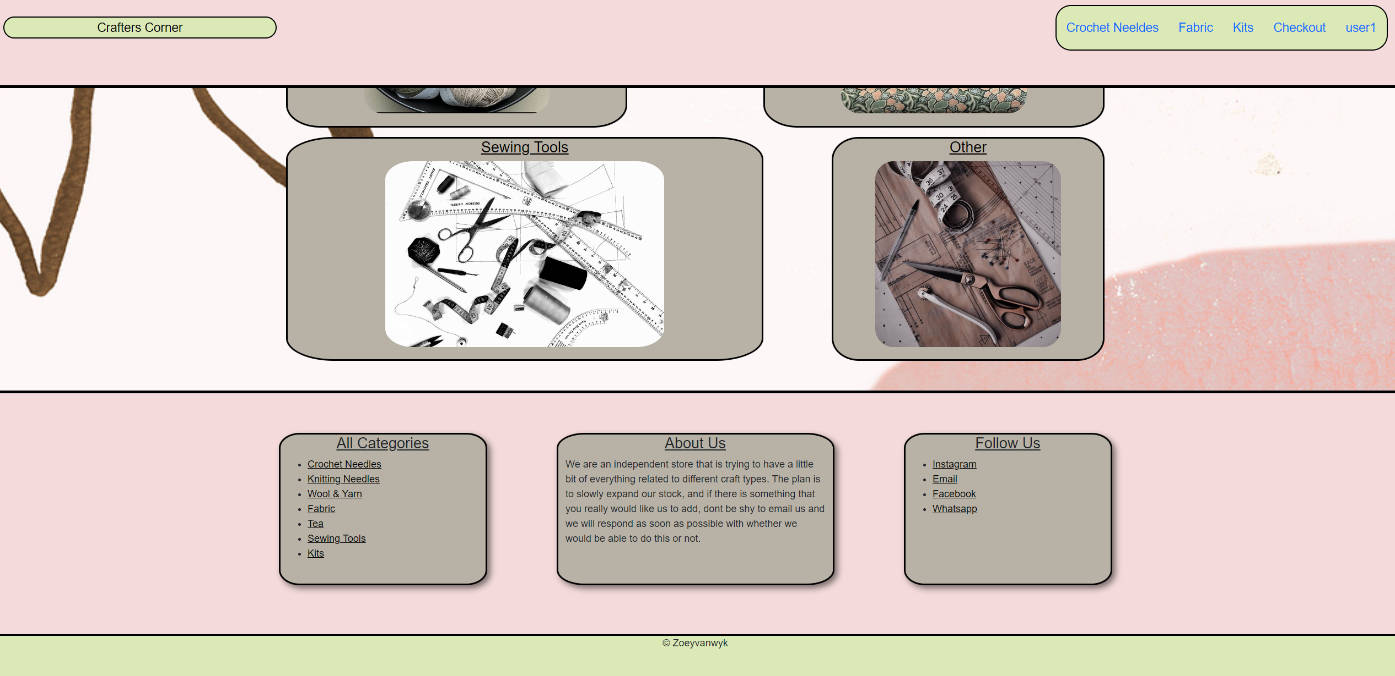
This is what the home page looks like, upon logging in it shows the username. The boxes shows the different pages and the all categories shows all different categories.

Slide 7
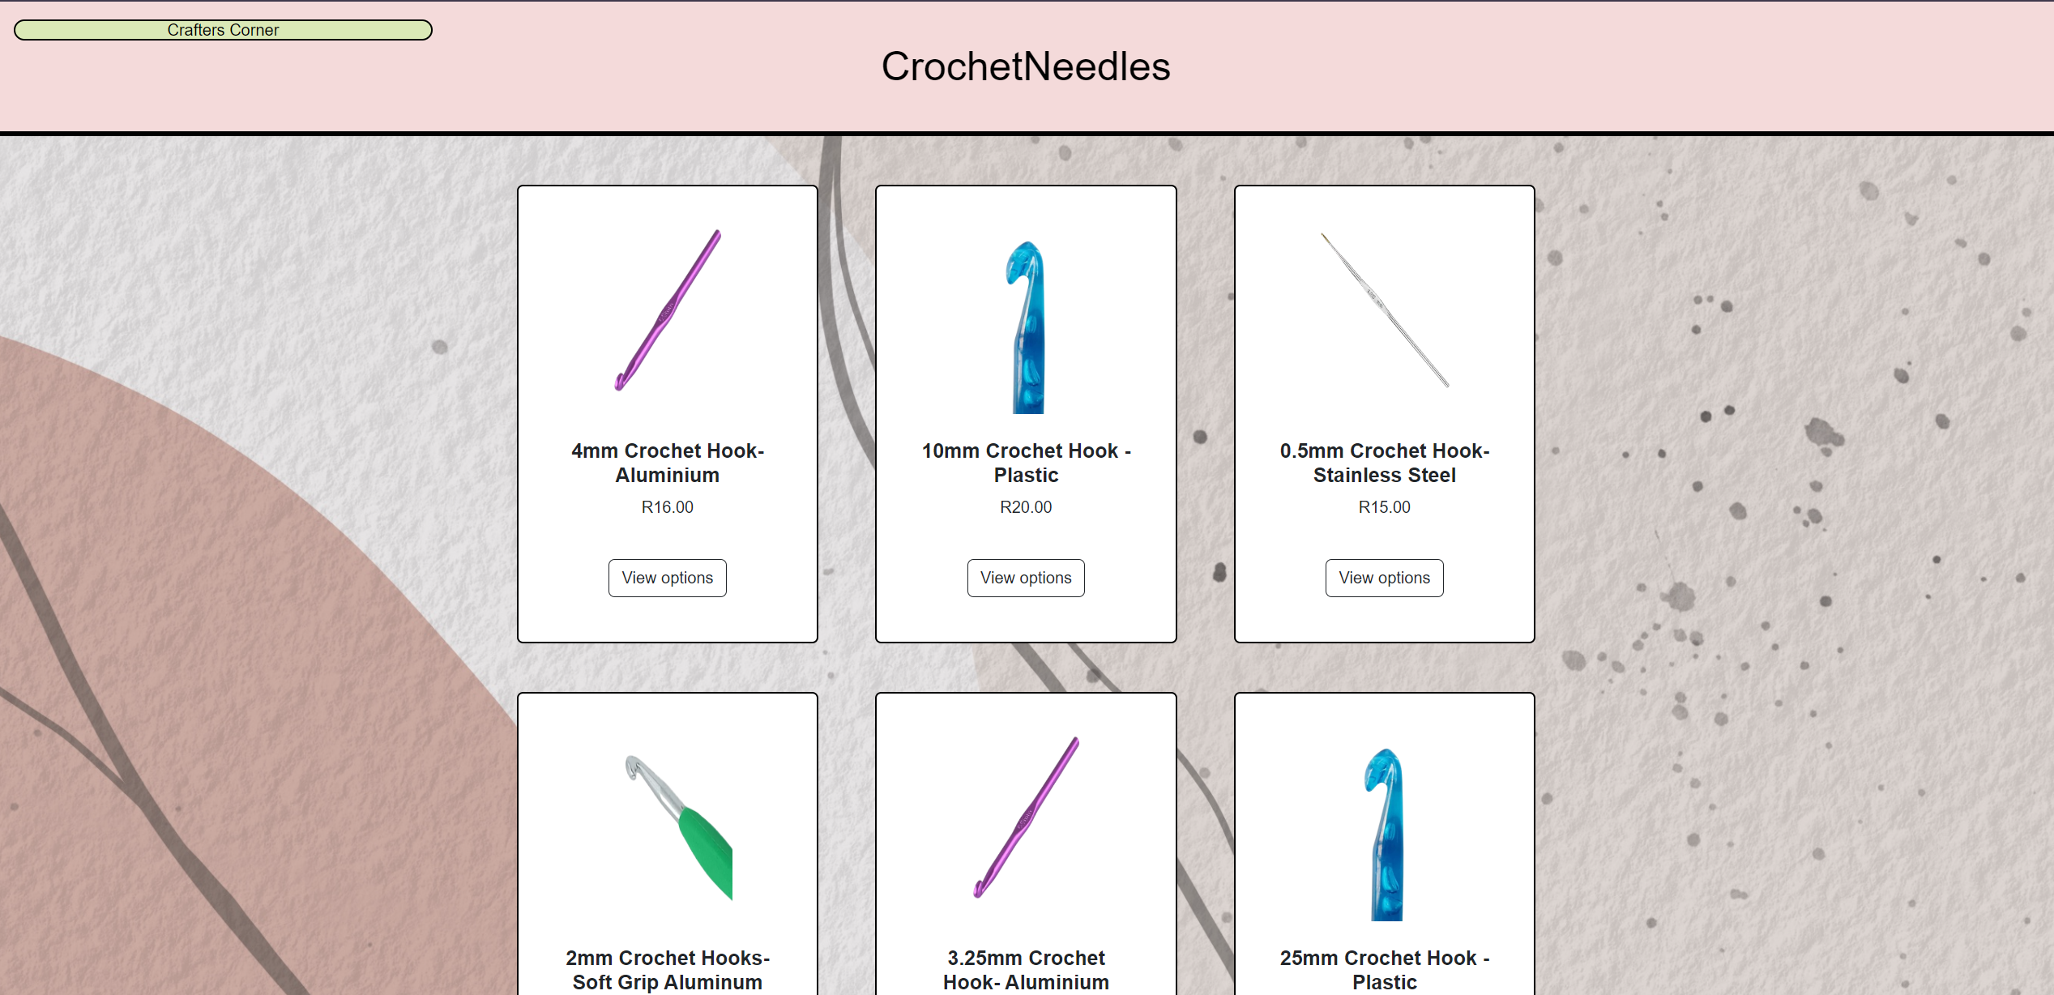
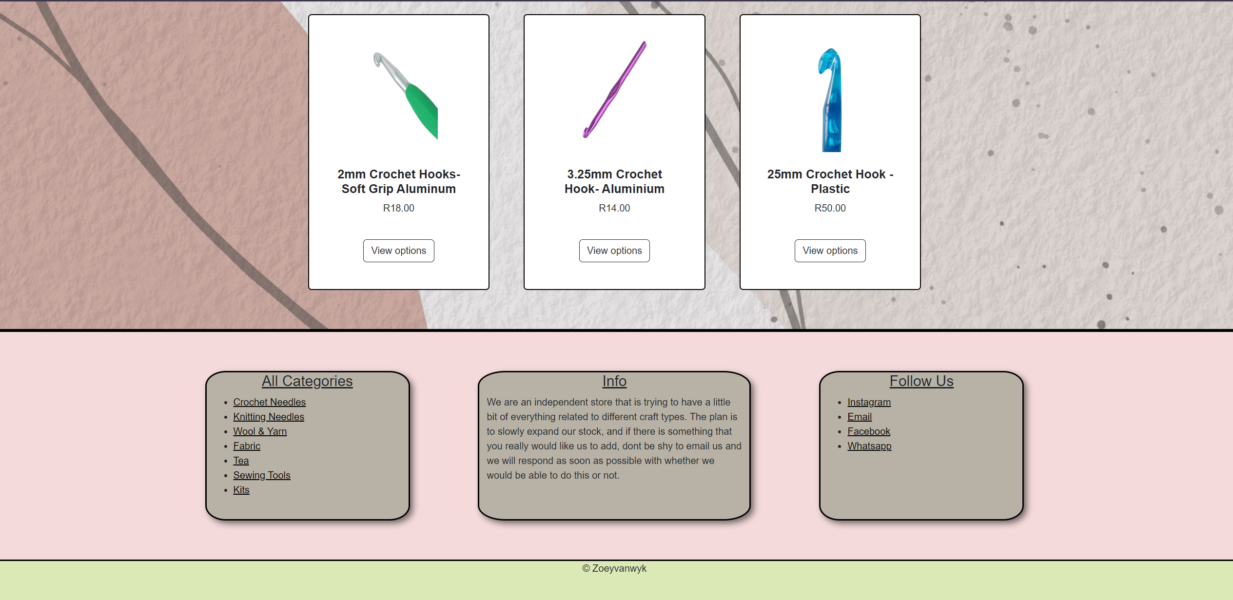
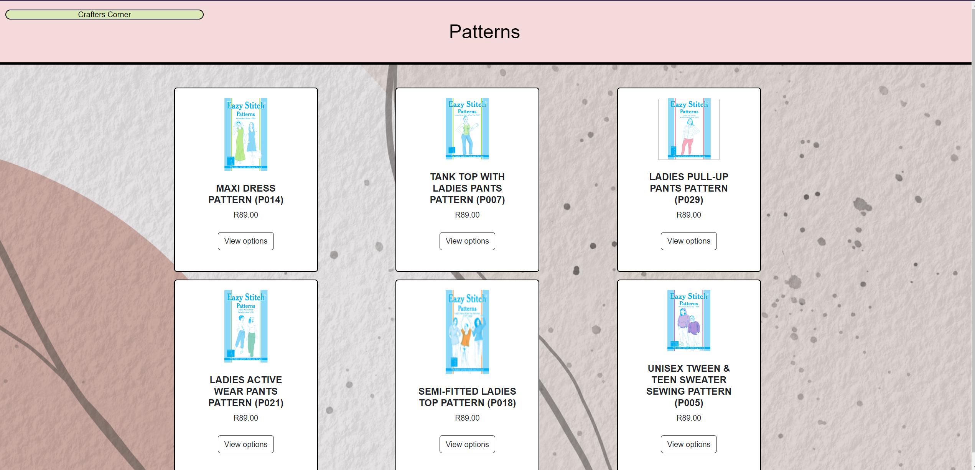
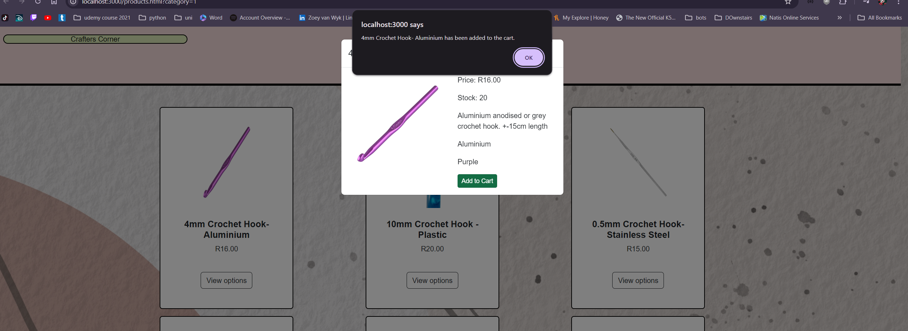
Screenshots with explanations
What the pages look like and the screenshot to the left shows what it looks like when you click on the view options button and then the popup that appears when the add to cart button is clicked

Slide 8
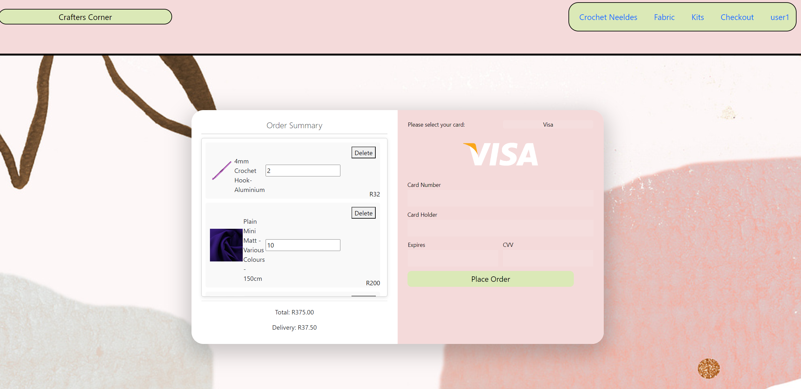
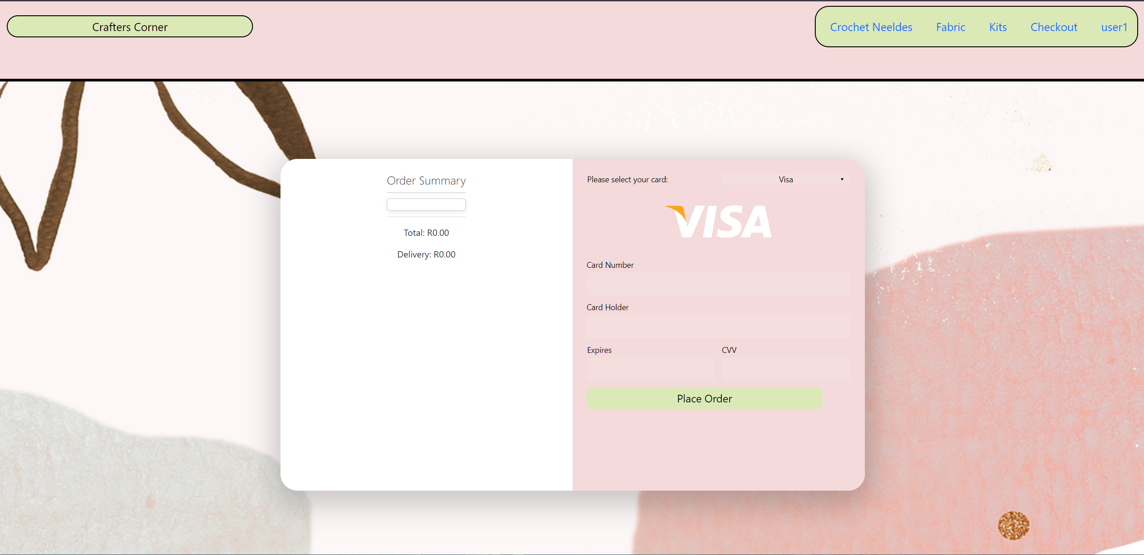
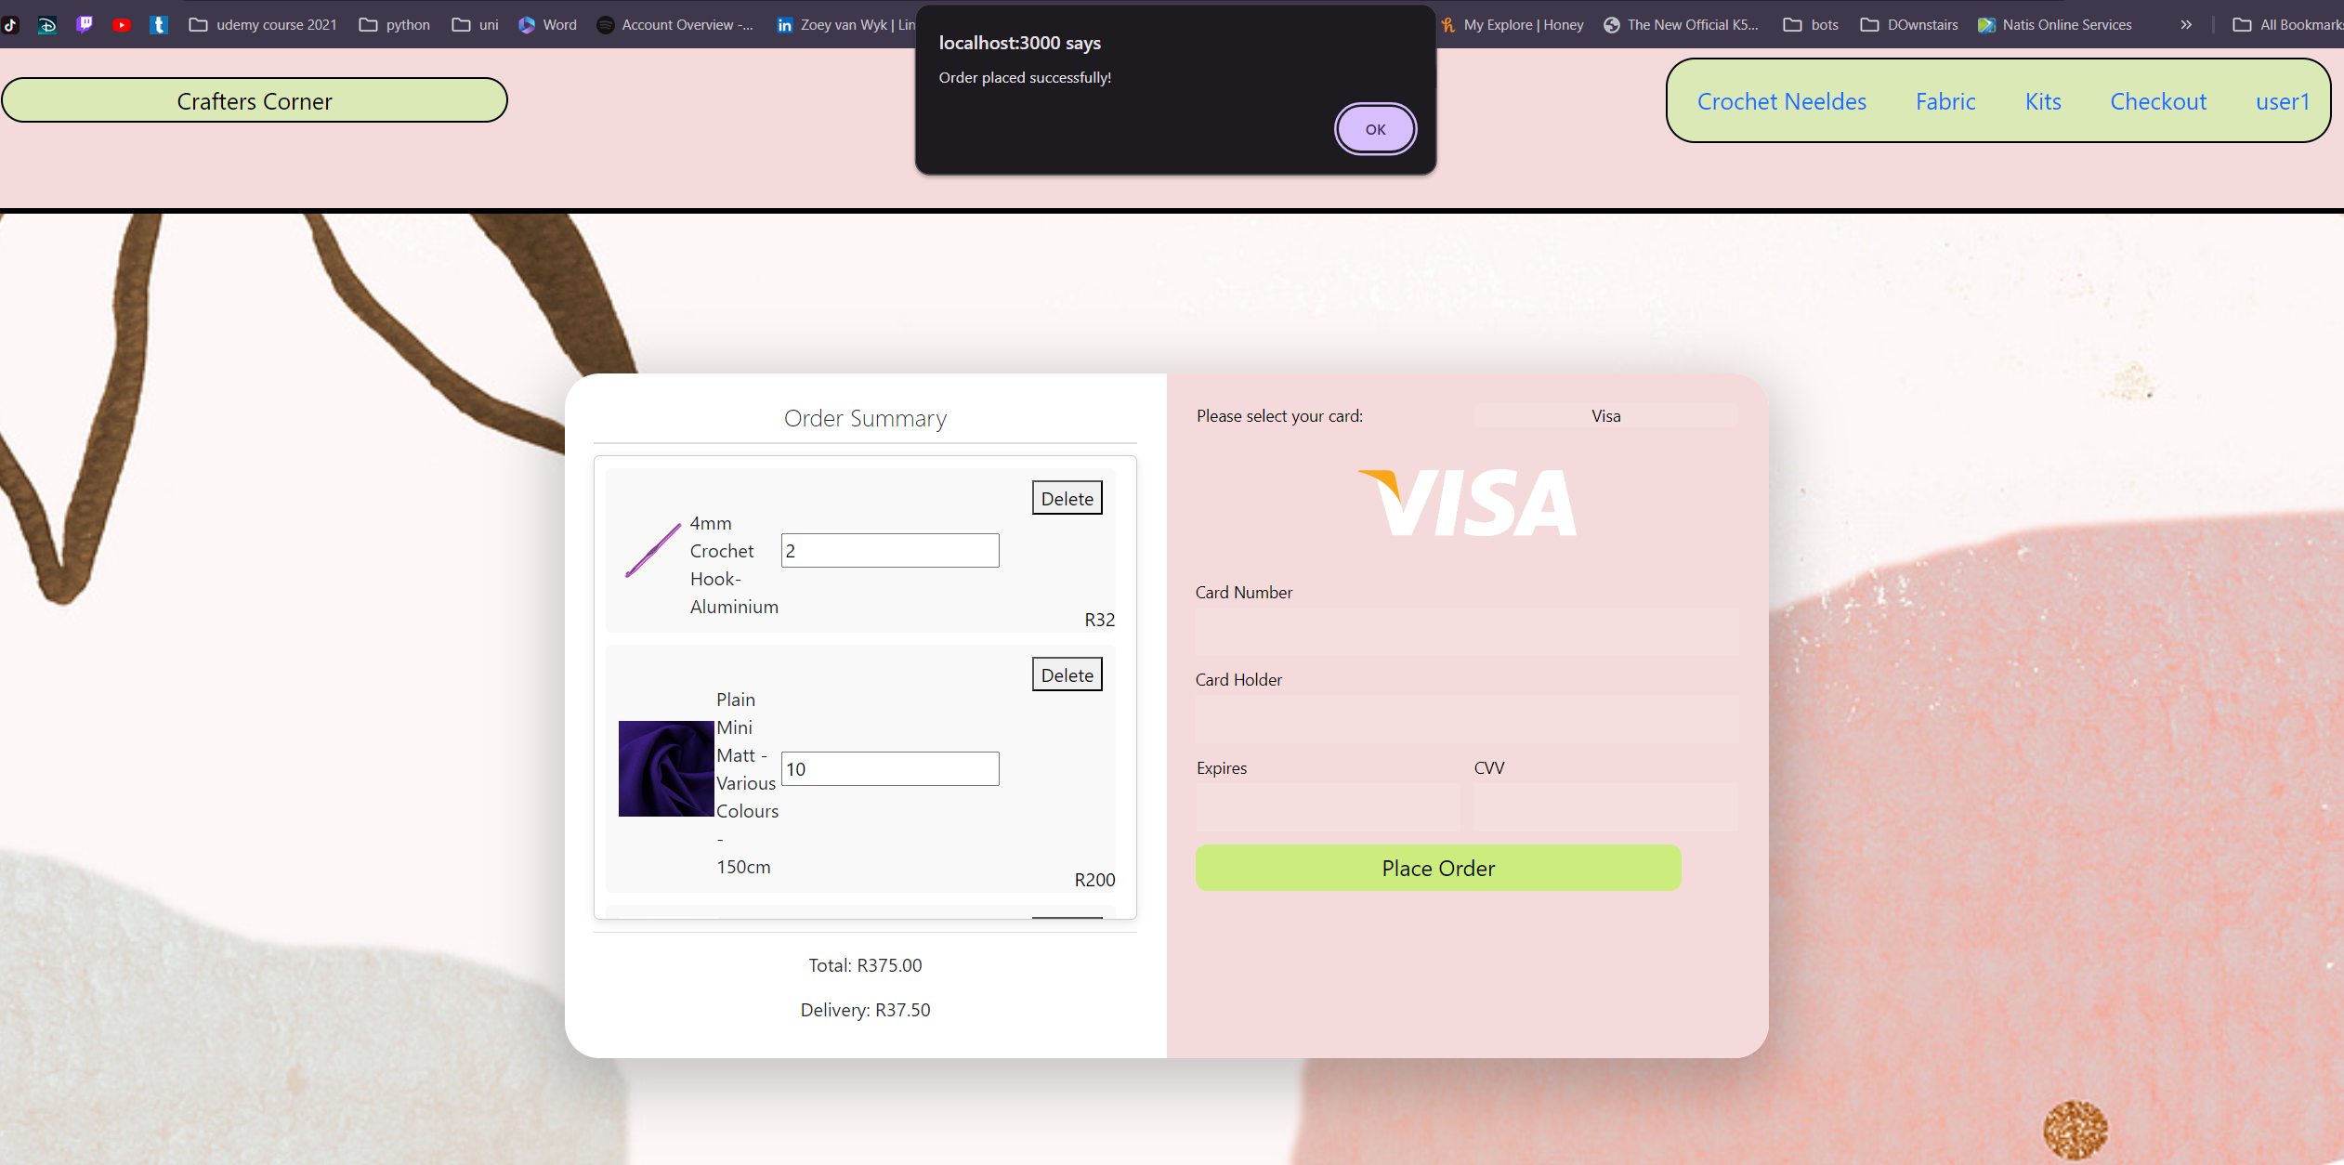
This is what the checkout page looks like it has the option to select between different payment types. It shows the items that are in the cart and shows the total.
Added functionality for shipping costs, and can now edit the amount in the cart and delete items from the cart.
The picture beneath shows what the checkout looks like without any items in it

Slide 9
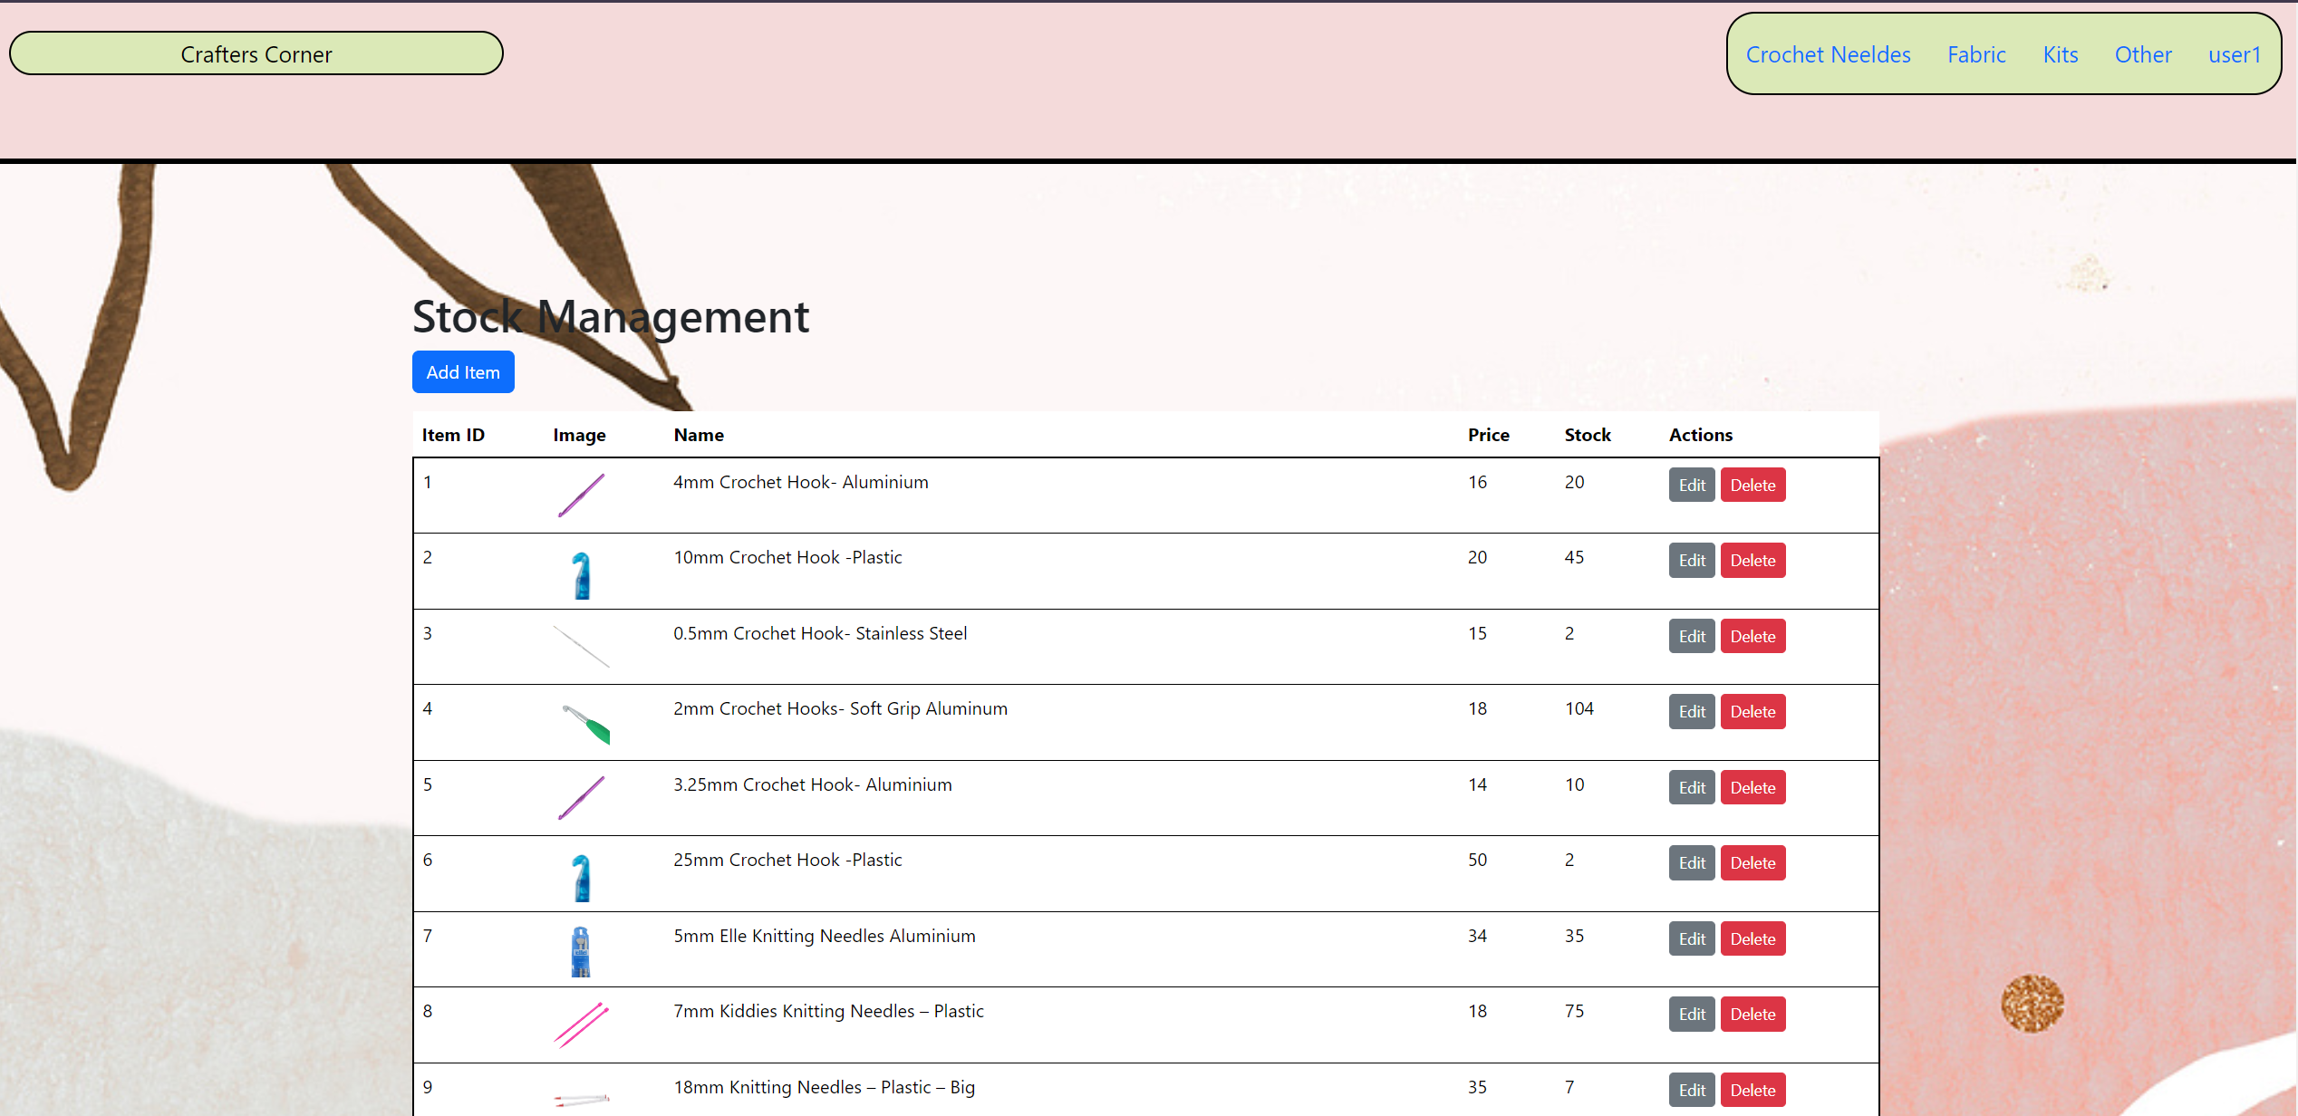
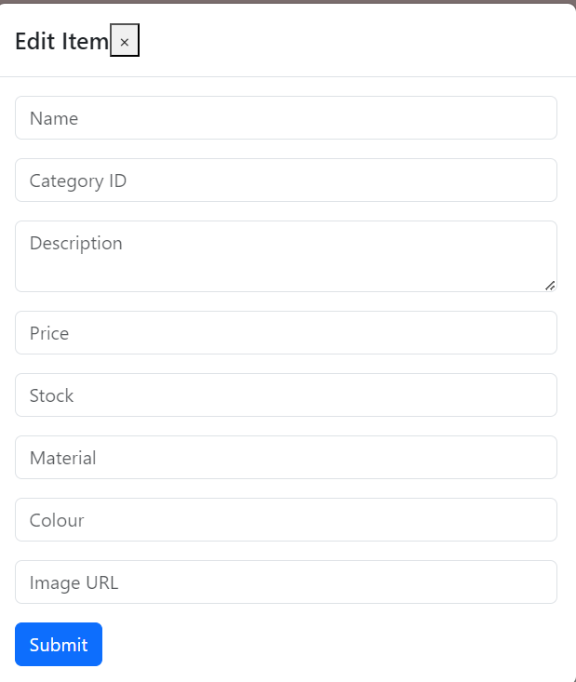
Screenshots with explanations
The stock page that only admins can access where all information on stock can be edited, new things can be added or deleted.
This is what the form looks like to edit and add items

Slide 10
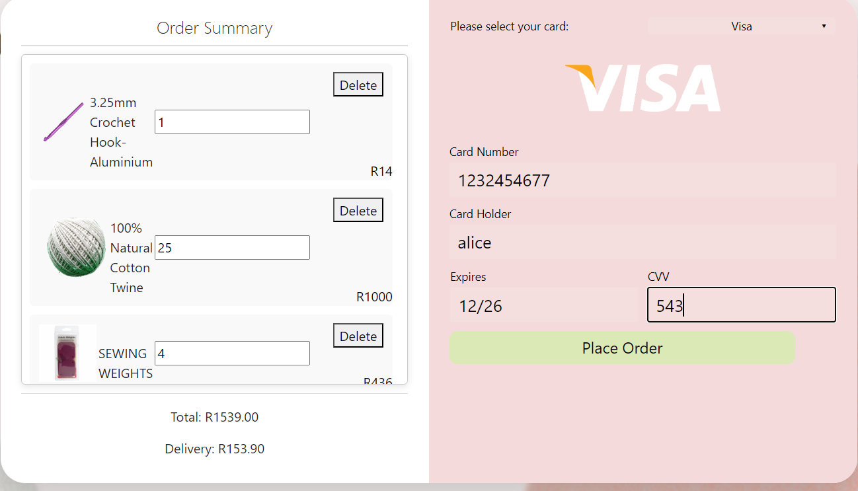
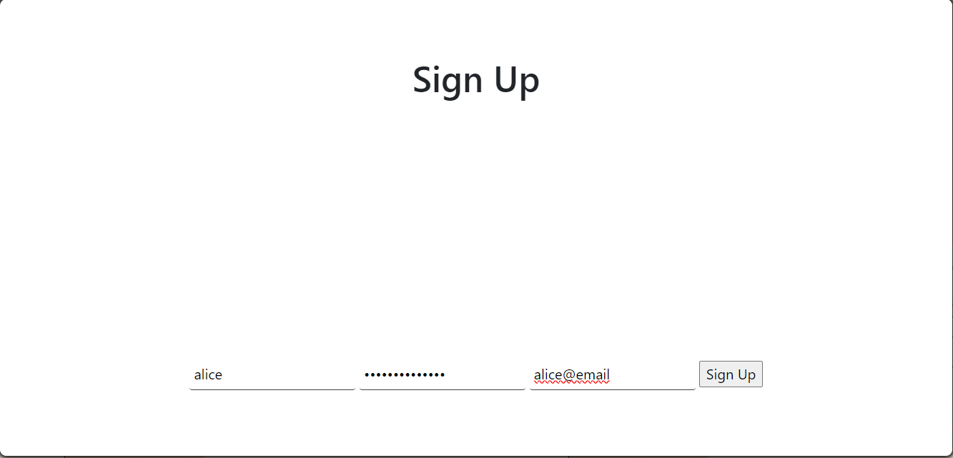
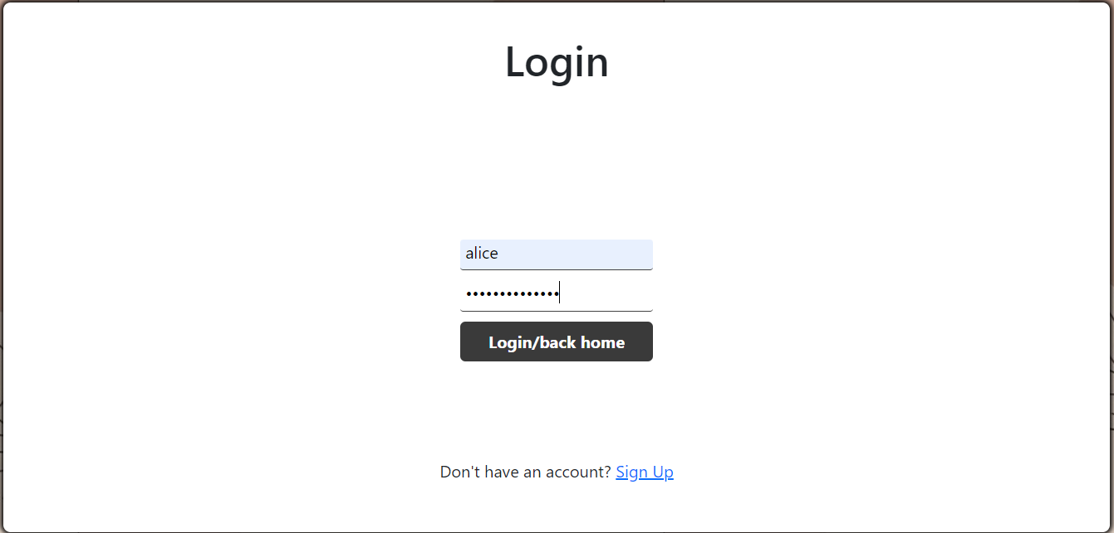
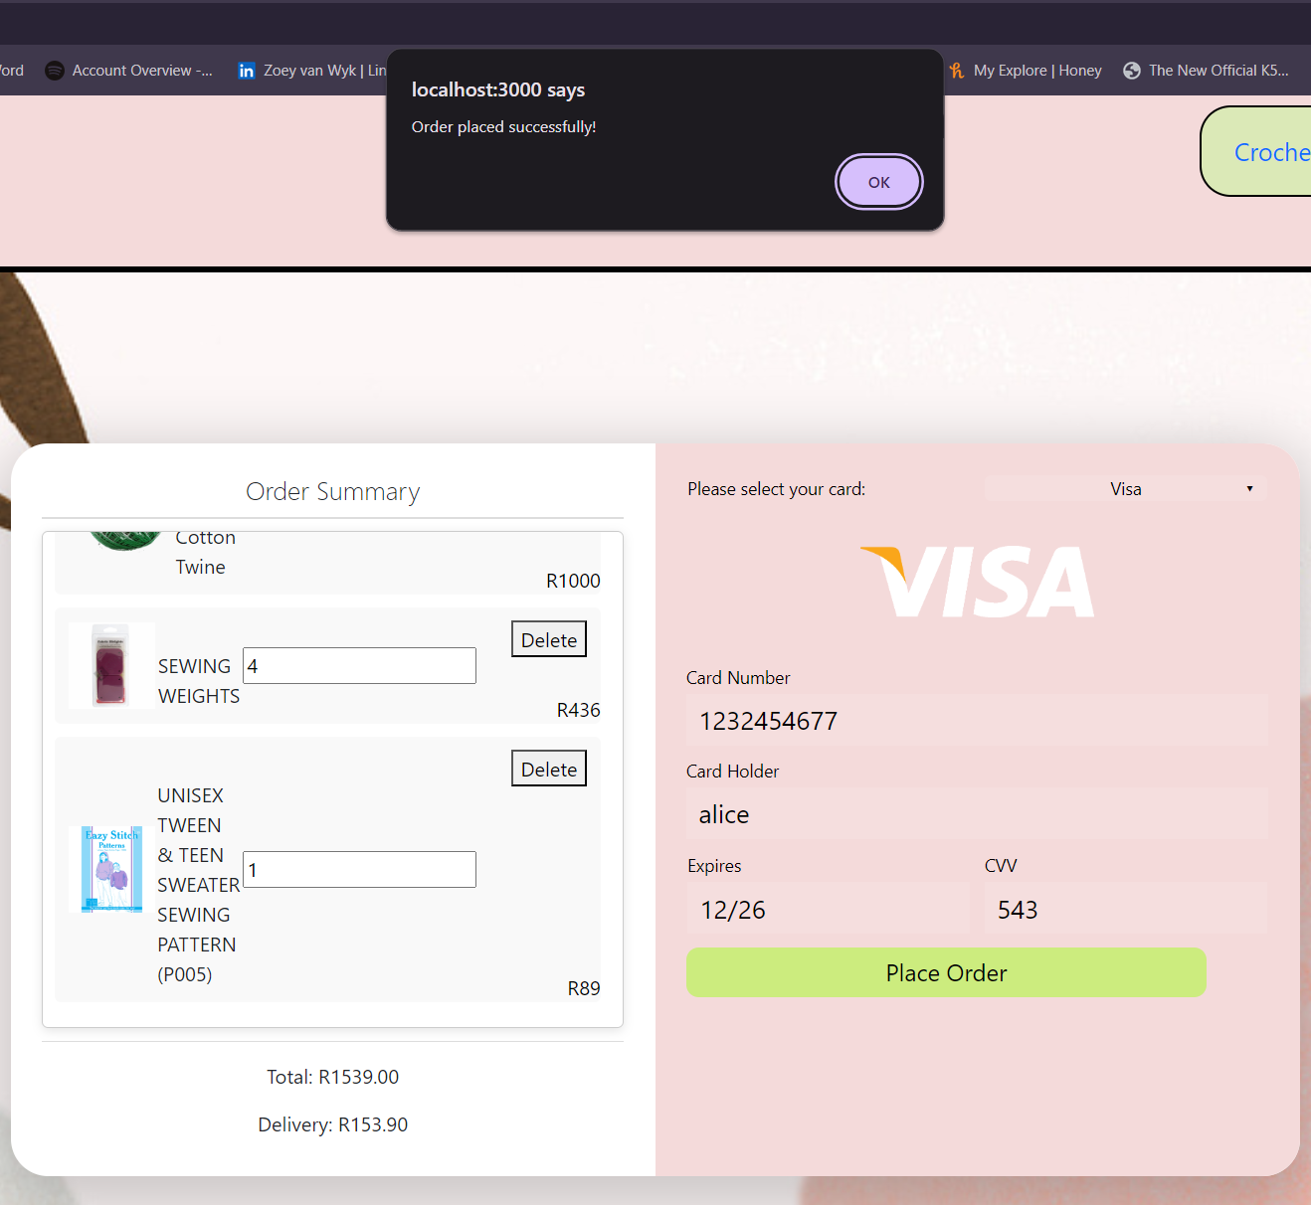
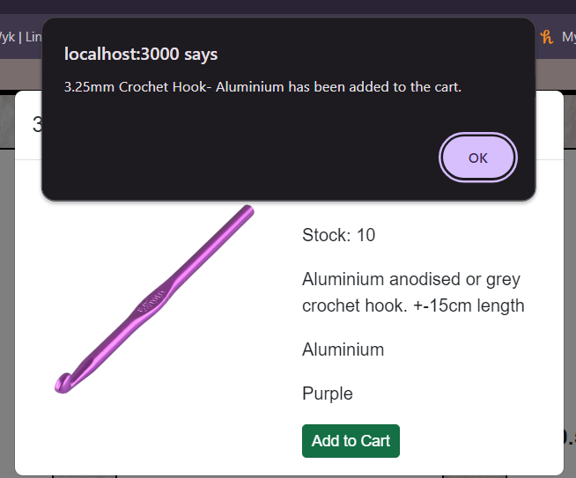
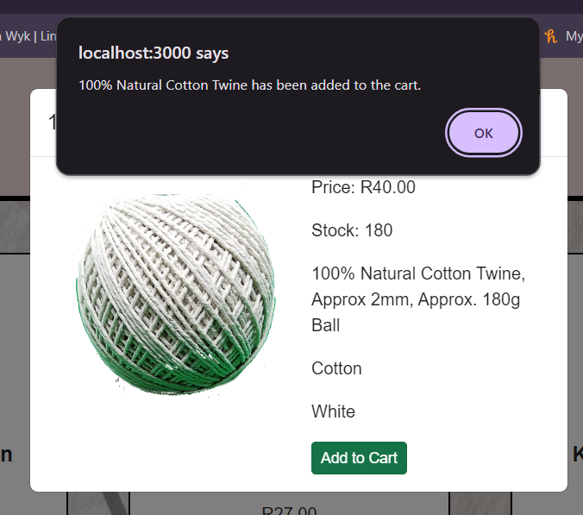
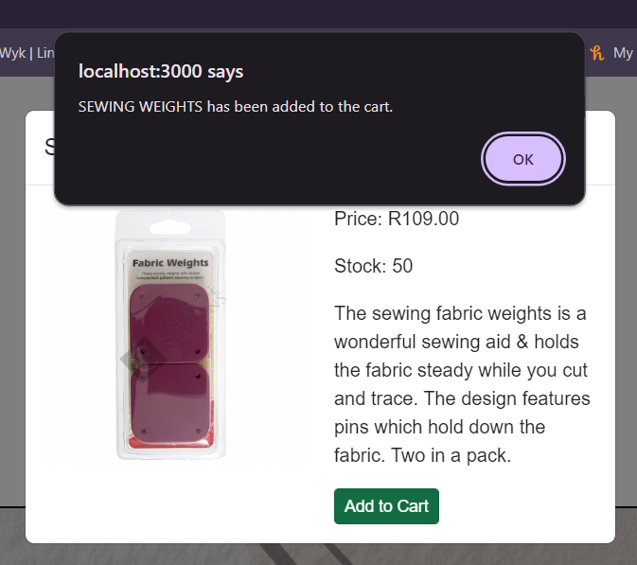
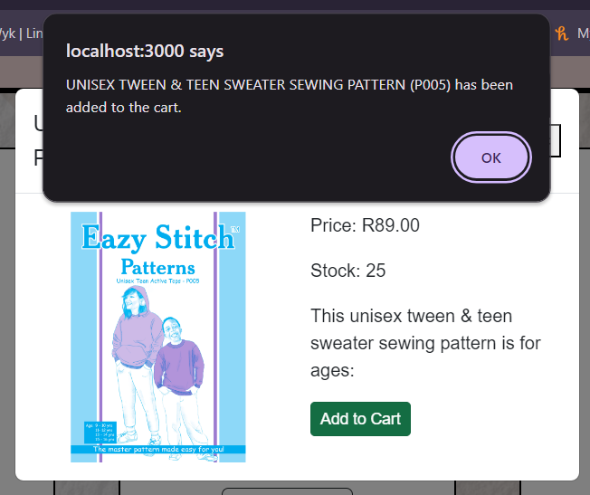
Test case
A new user logs in called Alice, she first created an account and then logs in
Alice then goes to the checkout page and changes the amount of each item that she wants and enters her bank info.
she then hits place order and her cart is cleared.
Alice then goes to different product pages to add different things for her project to make a sweater.

Slide 11
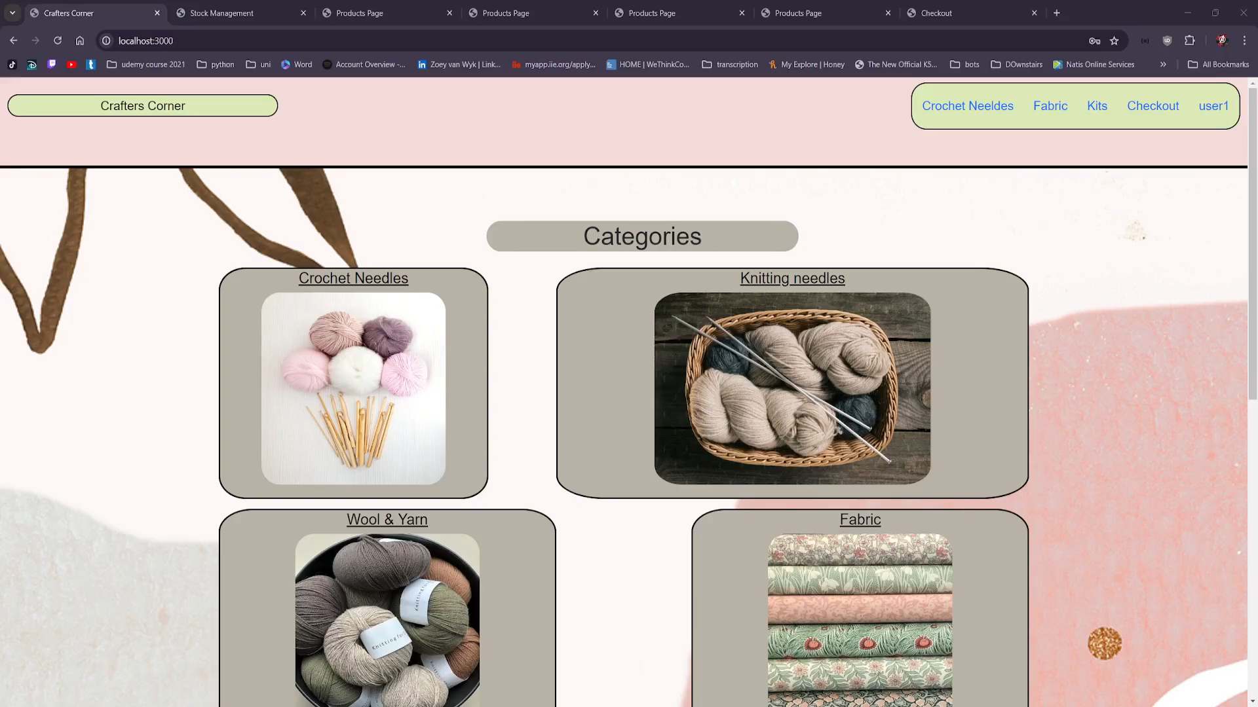
Issues and Screencast video
Current issues/ things to work on:
Struggling to get the links in the nav bar to be a different color
Couldn’t get the edit stock form to populate the current information

